Slide 1
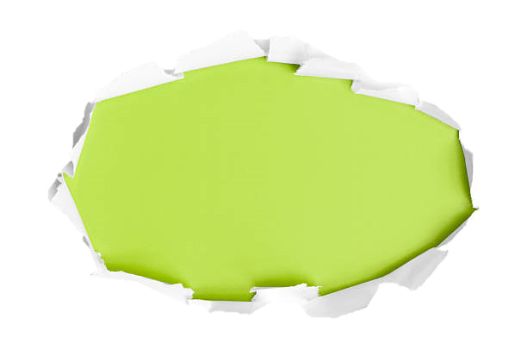

Slide 2



Slide 3
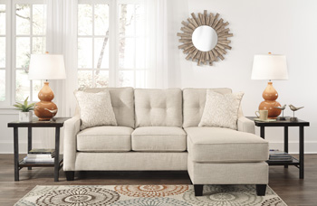
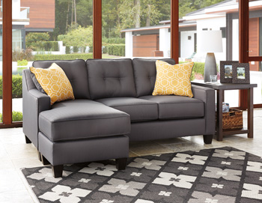
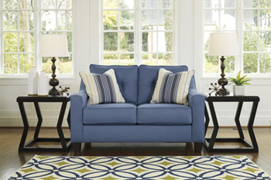

Slide 4
 | Frame constructions have been rigorously tested to simulate the home and transportation environments for improved durability. Corners are glued, blocked and stapled. Seats and back spring rails are cut from hardwood and engineered lumber. Stain- and abrasion-resistant Nuvella. | Inches: 80” W x 61” D x 38” H Minimum width of doorway for delivery 32.00" Seat depth 23.00" Seat height 21.00" Distance between arms 46.00" Top of cushion to top of back 19.00"
 | Stripes and patterns are match cut. All fabrics are pre-approved for wearability and durability against AHFA standards. Style features a reversible chaise cushion that allows for use on the left or right side of the unit. | Inches: 80” W x 61” D x 38” H Minimum width of doorway for delivery 32.00" Seat depth 23.00" Seat height 21.00" Distance between arms 46.00" Top of cushion to top of back 19.00"
 | Cushion cores are constructed of low melt fiber wrapped over high quality foam. Seats and back spring rails are cut from hardwood and engineered lumber. Stain- and abrasion-resistant Nuvella. | Inches: 58” W x 39” D x 38” H Minimum width of doorway for delivery 32.00" Seat depth 23.00" Seat height 21.00" Distance between arms 46.00" Top of cushion to top of back 19.00"
Exclusively at Accents @ home

